Slide 1
Direct proportion in context
Understanding multiplicative relationships: percentages and proportionality

Slide 2
how to use Oak lessons

Slide 3
I can recognise direct proportion in a range of contexts, including compound measures.

Slide 4
Two variables are in direct proportion if they have a constant multiplicative relationship.

Slide 5

Direct proportion in context
Conversions
Other contexts involving direct proportion

Slide 6
Conversions
Conversion between units of measure is an example of variables which are directly proportional. E.g.
converting between metric units
converting between units of time
converting between different currencies
converting between metric and imperial units

Slide 7
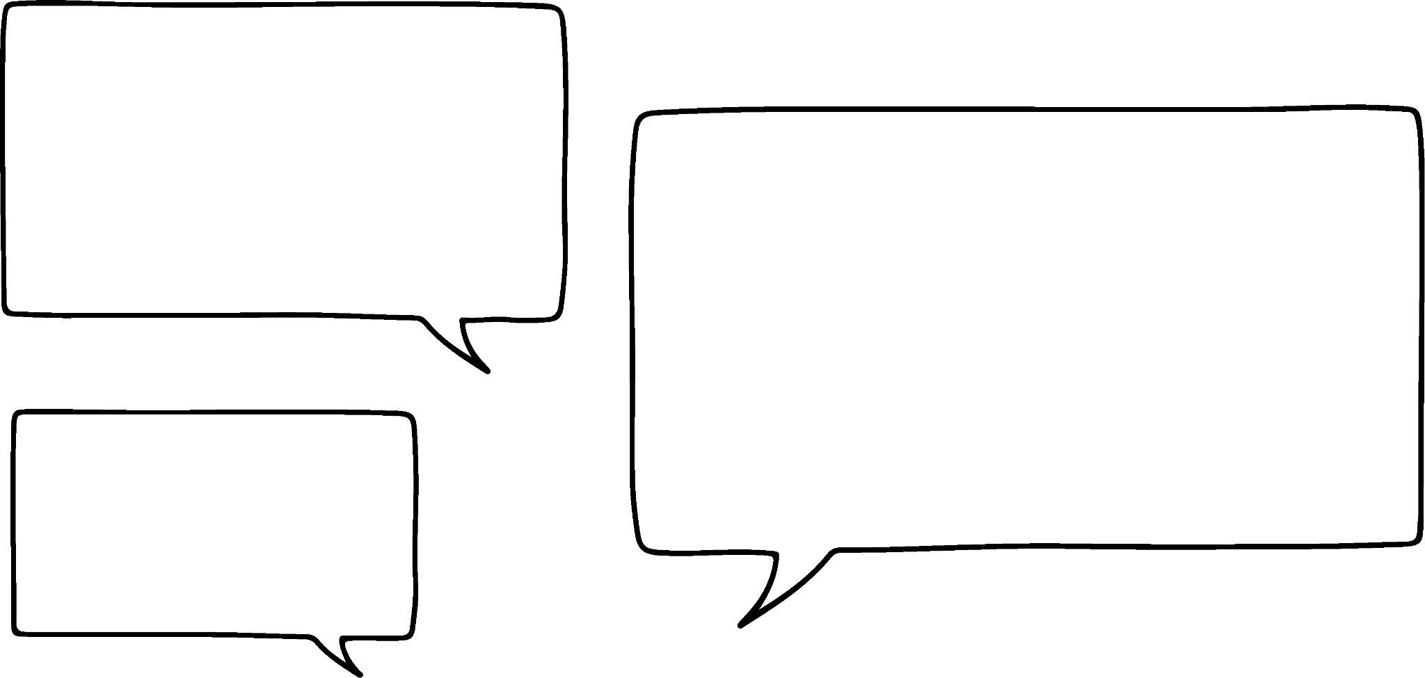

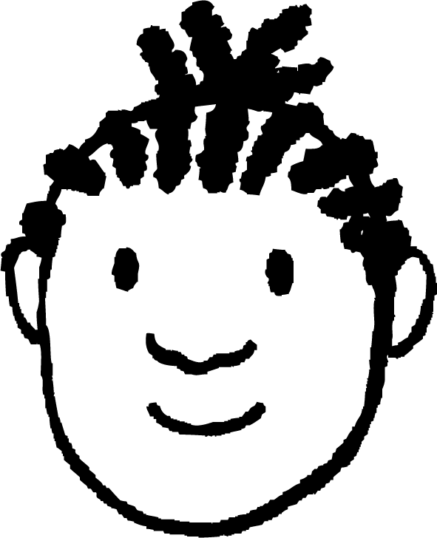
Conversions
Since directly proportional variables have a multiplicative relationship, we can use a ratio table to find other information.
My dad has a great way of remembering the miles and kilometres conversion fact.
When I run I measure it in kilometres but my mum always wants to know what it is in miles!
If you had a 5 mile wait in kilometres it would be 8
That is brilliant!
Aisha
Jacob

Slide 8
Conversions
How far did you run this weekend Jacob?
I ran 3 km on Saturday and 4 km on Sunday.
Aisha
Jacob
How far did Jacob run this weekend in miles?
miles | km
5 | 8
 | 7
miles | km
5 | 8
4.375 | 7
×
×
Jacob ran 4.375 miles at the weekend.

Slide 9
Conversions
Calculate the area of this rectangle.
1.24 m
5.62 m
6.969
Area = cm²
The area of a rectangle is length × width.
I’ll work that out. It is 1.24 × 5.62 = 6.969 m².
Is Jacob’s answer correct? No, the units on the answer line are cm² and not m².
Aisha
Jacob

Slide 10
Conversions
Calculate the area of this rectangle.
1.24 m
5.62 m
6.969
Area = cm²
We can change the unit of our answer. Centimetres and metres are directly proportional. Therefore, we can use a ratio table.
OK, let’s do that. There are 100 cm in a metre.
Aisha
Jacob

Slide 11
Conversions
Calculate the area of this rectangle.
1.24 m
5.62 m
696.9
Area = cm²
I have estimated the area by rounding 1.24 m to 100 cm and 5.62 m to 600 cm. This gives an area of 100 × 600 = 60 000 cm².
My answer of 696.9 cm² is not even close to 60 000 cm².
We will take a look at what is wrong with this method.
Aisha
Jacob

Slide 12
Conversions
We will start by looking at a 1 metre square.
1 m
100 cm
1 m
100 cm
Area = 1 × 1
= 1 m²
Area = 100 × 100 = 10 000 cm²
Are these exactly the same squares?
Yes, they are so they must have the same area. 1 m² = 10 000 cm²

Slide 13
Conversions
Calculate the area of this rectangle.
1.24 m
5.62 m
69 690
Area = cm²
m² | cm²
1 | 10 000
6.969
m² | cm²
1 | 10 000
6.969 | 69 690
× 10 000
× 10 000

Slide 14

Conversions
Convert 542 800 cm² into m²
1 m² = 10 000 cm²
5428 m²
542.8 m²
54.28 m²
542 800 ÷ 10 000 = 54.28 m²
5.428 m²

Slide 15
Conversions
Calculate the volume of this cuboid, giving your answer in m³.
20 cm
45 cm
1.2 cm
Let’s work out the proportional relationship between cm³ and m³.
All 3 dimensions will be multiplied by 100. Meaning, the overall effect will be × 1 000 000
Aisha
Jacob

Slide 16
Conversions
Calculate the volume of this cuboid, giving your answer in m³.
20 cm
45 cm
120 cm
Volume = 45 × 120 × 20
= 108 000 cm³
m³ | cm³
1 | 1 000 000
 | 108 000
m³ | cm³
1 | 1 000 000
0.108 | 108 000
÷ 1 000 000
÷ 1 000 000

Slide 17
Conversions
Convert 13.24 m³ into cm³
1 m³ = 1 000 000 cm³
132 400 cm³
1 324 000 cm³
13 240 000 cm³
13.24 × 1 000 000 = 13 240 000 cm³
132 400 000 cm³

Slide 18
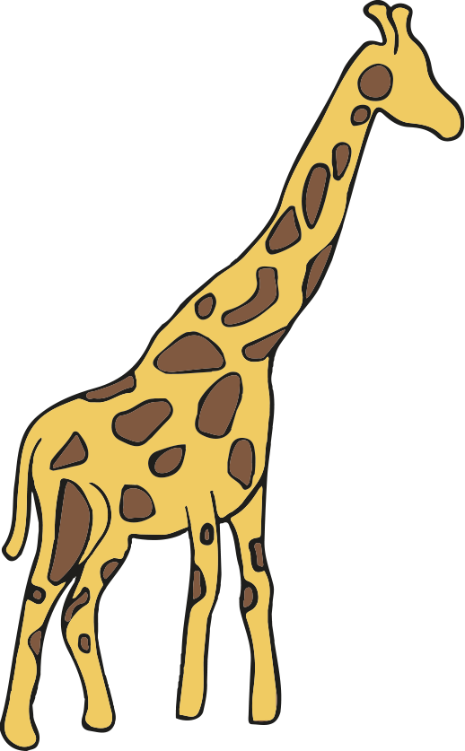
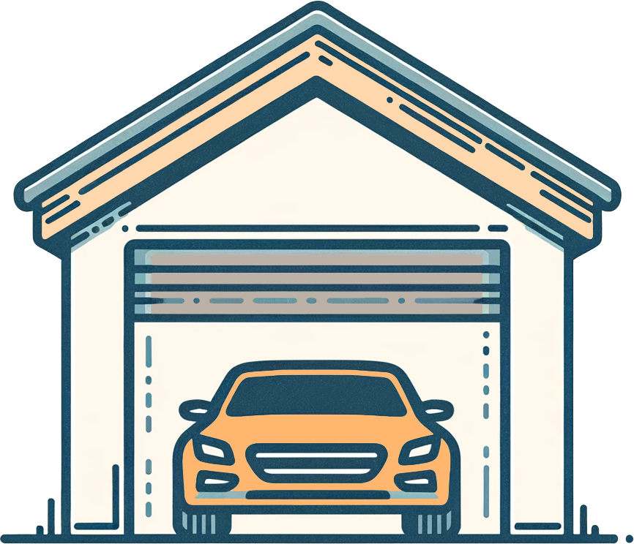



Conversions
Images are not to scale
1) Write the following in order from the shortest to the tallest, using the conversion 1 m = 3.3 feet
5.1 m
14.2 feet
5.1 m
2.4 m
10.2 feet
13.2 feet

Slide 19
Conversions
2)
Work out the maximum number of the boxes below that will fit into the box above.
A cube with dimensions of 40 mm b)
Images are not to scale
1.2 m
80 cm
1.6 m
0.04m
60 mm
4 cm

Slide 20
Conversions
3) Fill in the missing values:
3.2 m² = cm²
125 000 cm² = m²
23 987 000 cm³ = m³
0.74 m³ = cm³
4) Calculate the area of this triangle. Give your answer to 2 decimal places in m².
268 cm
86 cm
254 cm

Slide 21
Conversions
5) Calculate the volume of this cuboid.
Give your answer in cm³.
0.7 m
0.4 m
1.8 m

Slide 22
Conversions
Images are not to scale
1) Write the following in order from the shortest to the tallest, using the conversion 1 m = 3.3 feet
5.1 m
14.2 feet
5.1 m
2.4 m
10.2 feet
13.2 feet
Correct order: garage, elephant, teepee, bus, giraffe

Slide 23
Conversions
2)
Work out the maximum number of the boxes below that will fit into the box above.
a) A cube with dimensions of 40 mm b)
Images are not to scale
1.2 m
80 cm
1.6 m
0.04m
16 000
boxes
60 mm
30 × 40 × 20 = 24 000 boxes
4 cm

Slide 24
Conversions
3) Fill in the missing values:
3.2 m² = 32 000 cm²
125 000 cm² = 12.5 m²
23 987 000 cm³ = 23.987 m³
0.74 m³ = 740 000 cm³
4) Calculate the area of this triangle. Give your answer to 2 decimal places in m².
268 cm
1.09 m²
86 cm
254 cm

Slide 25
Conversions
5) Calculate the volume of this cuboid.
Give your answer in cm³.
504 000 cm³
0.7 m
0.4 m
1.8 m

Slide 26
Direct proportion in context
Conversions
Other contexts involving direct proportion

Slide 27
Other contexts involving direct proportion
As well as conversions there are other contexts which involve direct proportion. E.g.
changing between different currencies
scaling recipes
scaling the cost of particular items

Slide 28
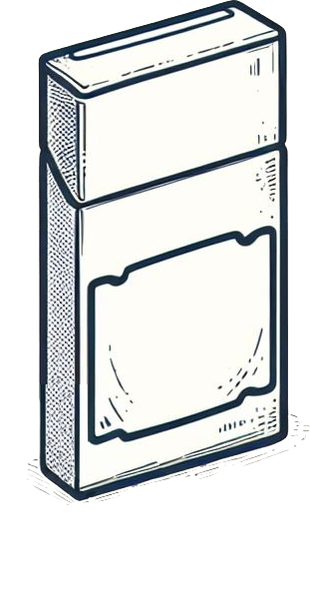
Other contexts involving direct proportion
The cost of pencils is directly proportional to the number of boxes.
boxes | cost (£)
1 | 3.24
boxes | cost (£)
1 | 3.24
18
boxes | cost (£)
1 | 3.24
18 | 58.32
£3.24
× 18
× 18
What is the cost of 18 boxes of pencils?
18 boxes of pencils cost £58.32

Slide 29
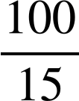
Other contexts involving direct proportion
The number of dollars received when exchanging currency is directly proportional to the number of pounds.
£ | $
15 | 18.90
100 | 126
£ | $
15 | 18.90
100
×
×
How many dollars will you get for £100?
You will get $126 for £100

Slide 30
Other contexts involving direct proportion
The amount of milk needed to bake scones is directly proportional to the number of scones being made.
scones | milk (ml)
15 | 180
scones | milk (ml)
15 | 180
 | 4.5
× 12
÷ 12
0.375
A cafe has 4.5 litres of milk. How many scones can they make?
Does my answer look right?
No
What mistake have I made?
I have forgotten to change the 4.5 l into ml which is the unit used in the recipe.

Slide 31
Other contexts involving direct proportion
The amount of milk needed to bake scones is directly proportional to the number of scones being made.
scones | milk (ml)
15 | 180
scones | milk (ml)
15 | 180
 | 4500
× 12
÷ 12
375
A cafe has 4.5 litres of milk. How many scones can they make?
The cafe can make 375 scones if they have 4.5 litres of milk.

Slide 32
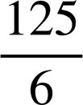
Other contexts involving direct proportion
The cost of batteries is directly proportional to the number bought.
12 packs cost £4.56
How many packs can you buy for £95?
The cost of batteries is directly proportional to the number bought.
15 packs cost £5.25
How many packs can you buy for £210?
Packs | Cost (£)
15 | 5.25
600 | 210
Packs | Cost (£)
12 | 4.56
250 | 95
Packs | Cost (£)
15 | 5.25
 | 210
Packs | Cost (£)
12 | 4.56
 | 95
× 40
× 40
×
×
You can buy 600 packs for £210
You can buy 250 packs for £95

Slide 33
Other contexts involving direct proportion
1) Work out the following:
a) 23 pencils cost £14.95 How much will 34 pencils cost?
b) 14 rulers cost £5.18 How much will 20 rulers cost?
c) 17 sweets cost £2.55 How much will 37 sweets cost?
d) 27 chocolate bars cost £11.07 How much will 39 chocolate bars cost?

Slide 34

Other contexts involving direct proportion
2) Andeep is comparing prices of sunglasses in the UK, the USA and France.
Rank the following from cheapest to most expensive.
£1 : $1.28
£1 : €1.18
£48.00
$60.80
€57.23

Slide 35
Other contexts involving direct proportion
3) Calculate the ingredients needed for the following numbers of cookies.
a) 18 cookies
b) 72 cookies
c) 6 cookies
d) You have plenty of sugar, flour and chocolate chips, but only 1 kilogram of butter. What is the largest number of cookies you can make?
Recipe for 15 cookies
75 g butter
125 g sugar
125 g flour
100 g chocolate chips

Slide 36




Other contexts involving direct proportion
a) 23 pencils cost £14.95 How much will 34 pencils cost?
14.95 × = £22.10
b) 14 rulers cost £5.18 How much will 20 rulers cost?
5.18 × = £7.40
c) 17 sweets cost £2.55 How much will 37 sweets cost?
2.55 × = £5.55
d) 27 chocolate bars cost £11.07 How much will 39 chocolate bars cost?
11.07 × = £15.99
1)

Slide 37
Other contexts involving direct proportion
2) Andeep is comparing prices of sunglasses in the UK, the USA and France.
Rank the following from cheapest to most expensive.
£1 : $1.28
£1 : €1.18
£48.00
$60.80
€57.23
£ | $
1 | 1.28
47.50 | 60.80
£ | €
1 | 1.18
48.50 | 57.23
In order from cheapest to most expensive: USA, UK & France.

Slide 38
Other contexts involving direct proportion
3) Calculate the ingredients needed for the following numbers of cookies.
a) 18 cookies
Butter 90 g
Sugar 150 g
Flour 150 g
Chocolate chips 120 g
Recipe for 15 cookies
75 g butter
125 g sugar
125 g flour
100 g chocolate chips

Slide 39
Other contexts involving direct proportion
3) Calculate the ingredients needed for the following numbers of cookies.
b) 72 cookies
Butter 360 g
Sugar 600 g
Flour 600 g
Chocolate chips 480 g
Recipe for 15 cookies
75 g butter
125 g sugar
125 g flour
100 g chocolate chips

Slide 40
Other contexts involving direct proportion
3) Calculate the ingredients needed for the following numbers of cookies.
c) 6 cookies
Butter 30 g
Sugar 50 g
Flour 50 g
Chocolate chips 40 g
Recipe for 15 cookies
75 g butter
125 g sugar
125 g flour
100 g chocolate chips

Slide 41
Other contexts involving direct proportion
3) Calculate the ingredients needed for the following numbers of cookies.
d) You have plenty of sugar, flour and chocolate chips, but only 1 kilogram of butter. What is the largest number of cookies you can make?
1 kg = 1000 g
1000 ÷ 75 = 13.333
13.3 × 15 = 200
Recipe for 15 cookies
75 g butter
125 g sugar
125 g flour
100 g chocolate chips
The 13.3… represents the number of times you could make the recipe for cookies.
Since you can scale the recipe 13 and one third times you could make 200 cookies.
.

Slide 42
Other contexts involving direct proportion
Alternative method for part d)
d) You have plenty of sugar, flour and chocolate chips, but only 1 kilogram of butter. What is the largest number of cookies you can make?
1 kg = 1000 g
75 ÷ 15 = 5
1000 ÷ 5 = 200
Recipe for 15 cookies
75 g butter
125 g sugar
125 g flour
100 g chocolate chips
The 5 represents the number of grams of butter needed per cookie.
Since you have 1000 g of butter you could make 200 cookies.

Slide 43
Direct proportion in context
Conversion between units of measure are an example of variables which are directly proportional.
1 m² = 10 000 cm²
1 m³ = 1 000 000 cm³
As well as conversions there are other contexts which involve direct proportion. E.g.
changing between different currencies
scaling recipes
scaling the cost of particular items
Ratio tables can be used to solve direct proportion problems.

Slide 44

© Oak National Academy 2024.
Produced in partnership with Mathematics in Education and Industry.
Licensed on the Open Government Licence v3.0, except where otherwise stated. See Oak terms and conditions.

